Slide 1
Welcome

Slide 2
What is Machine Learning?
Machine learning is an application of artificial intelligence (AI) that provides systems the ability to automatically learn and improve from experience without being explicitly programmed.

Slide 3
Example
RECOMMENDATION ENGINES
Example: Netflix viewing suggestions
Application area: Media + Entertainment + Shopping
Using machine learning to curate its enormous collection of TV shows and movies, Netflix taps the streaming history and habits of its millions of users to predict what individual viewers will likely enjoy.

Slide 4
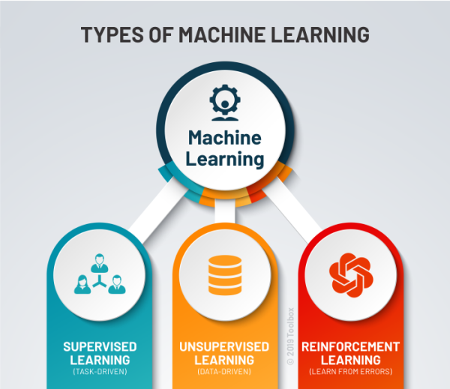

Slide 5
Supervised Learning
Supervised learning is one of the most basic types of machine learning. In this type, the machine learning algorithm is trained on labeled data. Even though the data needs to be labeled accurately for this method to work, supervised learning is extremely powerful when used in the right circumstances.

Slide 6
Unsupervised Learning
In supervised learning, the labels allow the algorithm to find the exact nature of the relationship between any two data points. However, unsupervised learning does not have labels to work off of, resulting in the creation of hidden structures. Relationships between data points are perceived by the algorithm in an abstract manner, with no input required from human beings.

Slide 7
Reinforcement Learning
Reinforcement learning directly takes inspiration from how human beings learn from data in their lives. It features an algorithm that improves upon itself and learns from new situations using a trial-and-error method. Favorable outputs are encouraged or ‘reinforced’, and non-favorable outputs are discouraged or ‘punished’.

Slide 8
Introduction
This project is based on Supervised Machine Learning. So, we require both inputs and outputs. Inputs are features (independent variables). They are generally indicated by ‘x’. Outputs are dependent variables. They are generally indicated by ‘y’. In this dataset, features are GRE scores, TOEFL scores, University Rating, Statement of Purpose (SOP), Recommendation Strength (LOR), CGPA, Research. Independent variable is Chance of Admit. In this project, ML models to predict the ‘Chance of Admit’ with minimum MSE and RMSE and maximum R-Square score are built. Following models are built :
Multiple Linear Regression
Random Forest Regression
Multiple Linear Regression with Principal Component Analysis
Random Forest Regression with Principal Component Analysis

Slide 9
Multiple Linear Regression
The regression is used to find the relationship between variables. In Machine Learning and in Statistical modelling, that relationship is used to predict the outcome of future events. Linear Regression uses the relationship between the data-points to draw a straight line through all them. Multiple Regression is like Linear Regression, but with more than one independent value or variables. Output will always be one. ‘x_train’ and ‘y_train’ are trained by fitting them in model using the object of LinearRegression class. Predict() takes ‘x_train’ as argument to predict the output (y_pred). This predicted output (y_pred) can be compared with actual output (y_test) to check accuracy. Plotting more than 3 dimension is not possible so Automatic Backward Elimination is used. It removes the least significant features which affects less in predicting output. After that again training and modelling can be done for predicting output. scatter() and plot() are used for plotting graph.

Slide 10
Random Forest Regression
Random Forest is a popular Machine Learning Algorithm. It can be used for both Classification and Regression problems. Here it is used as Random Forest Regression as it is a regression problem. It is based on the concept of ensemble learning. Multiple algorithms are combined to solve complex problem & to improve the performance of the model. It takes prediction from each tree and based on the average, predicts the final output. ‘x_train’ and ‘y_train’ are trained by fitting them in model using the object of RandomForestRegressor class. Predict() takes ‘x_train’ as argument to predict the output (y_pred). This predicted output (y_pred) can be compared with actual output (y_test) to check accuracy. The advantage of RF is that it takes less training time compared to other algorithm. It predicts output with high accuracy even for large dataset. scatter() and plot() are used for plotting graph.

Slide 11
Multiple Linear Regression with Principal Component Analysis
Plotting more than 3 dimension is not possible and moreover working with multiple features can be inefficient. Principal Component Analysis is most popular dimensionality reduction algorithm. It detect correlation and covariance between features (as it is unsupervised algorithm it considers only input). The goal is to reduce the dimensions of a d-dimensional dataset by projecting it onto a (k)-dimensional subspace (where k<d) in order to increase the computational efficiency while retaining most of the information. Using the object of PCA class, fit_transform() takes x as argument and fit x in model and transform x into required features. After PCA, only significant features are left and these features are splitted into train set and test set. Now modeliing procedure is similar to Multiple Linear Regression as described above.

Slide 12
Random Forest Regression with Principal Component Analysis
Principal Component Analysis is done on dataset by performing EDA and Pre-processing. As described above, dimensionality reduction is done similarly. After splitting x (new features) and y into train set and test set, both are trained and fitted in random forest regressor model and output is predicted in a similar way as mentioned in RFR.

Slide 13
Accuracy Checking Methods :-
MAE : Mean Absolute Error represents the difference between original values & predicted values extracted by averaged difference.
MSE : Mean Squared Error represents the difference between original values & predicted values extracted by squared the average distance.
RMSE : Root Mean Squared Error is the error rate by the square root of MSE.
R-Squared : It represents the coefficient of how well the values fit compared to the original values. Its value lies between 0 & 1. 1 indicates model fits perfectly to dataset.

Slide 14
Conclusion
ACM\Model | MLR | MLR_PCA | RFR | RFR_PCA
MSE | 0.0025 | 0.0032 | 0.0028 | 0.0040
RMSE | 0.0500 | 0.0569 | 0.0533 | 0.0637
R2_Score | 0.883 | 0.837 | 0.867 | 0.810
From the above given table, we can conclude that Mean Squared Error of Multiple Linear Regression is least i.e., 0.0025 which can be considered as good among all other models. Root Mean Squared Error of Multiple Linear Regression is least i.e., 0.0500 which can be considered good among all other models. R-Squared Score of Multiple Linear Regression is Highest i.e., 88% which can be said that model best fits to dataset. Random Forest Regression with Principal Component Analysis has highest MSE and RMSE which is not good for model. Moreover it has least R2_score i.e., 0.810 among all models, which is shows model does not fit well in dataset

Slide 15
Thank You…!!!

